Slide 1


Slide 2
Project Name : Semester Schedule System
Supervisor Name: Sir Shehzad Rizwan

Slide 3
Group Member Name:
Name : Muhammad Shehzad
Reg# CIIT/FA16-BCS-039/ATK
Name: Saleem Khan
Reg# CIIT/FA16-BCS-051/ ATK

Slide 4
Outlines
Abstract
Introduction
Objectives
Related Work
Tools
Use Case
User Interface
Conclusion
Future Work

Slide 5
Abstract:
The main propose of semester schedule system which is going to be an android app which faculty member and students both will be able to check their schedules.
The app will have a calendar containing schedule of the whole semester starting from day 1. In this app we will provide complete schedule of the semester including assignment, quizzes, sessional, terminal and other important dates. Our app will generates one day early notification before deadline which will facilitates the student and teacher to check their schedule using app.

Slide 6
Introduction:
This system facilities the students and faculty by saving their time and also reduces the efforts of student and teacher. And semester schedule system provide the complete calendar of the semester and provide the facility to a teacher to show quizzes assignment sessional terminal date and also show delay date

Slide 7
Objectives:
Students can easily know about all activity of a semester from mobile phone.
Save time and also reduce the efforts of students.
Students and faculties can access system from anywhere
Faculty can do everything within a time, such as submitted quizzes and assignment etc.
Faculty can manage their time and see the complete calendar.

Slide 8
Related Work
There are two android apps
My study life:
the main purpose of app is to notify a quiz, assignment and exam details
Another app is
Timetable++:
This app is also work to notify classes time and exams details.

Slide 9
Tools
Microsoft Word is used for Documentation
Xml is used for UI design
MS SQL server is used for real time database
Restful Api Used
Languages Used
Java (used in Android Studio)
Python(Calendar Algorithm Used)

Slide 10
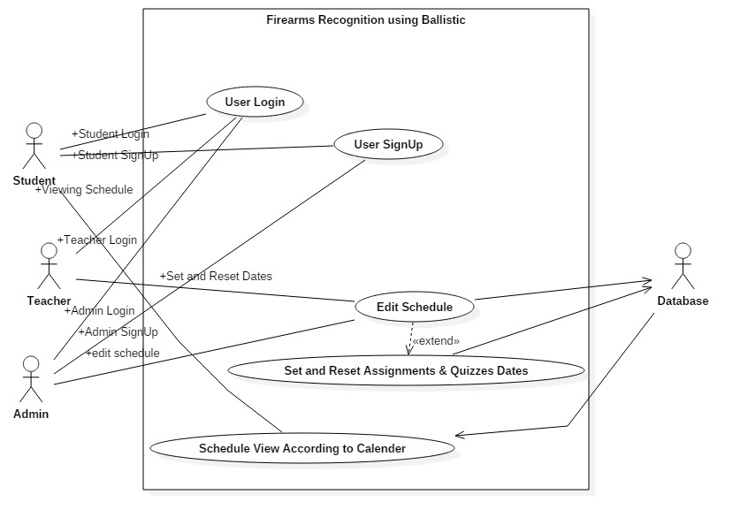
Use Case Diagram:

Slide 11
User Interface
Interface snippets are on next slides

Slide 12
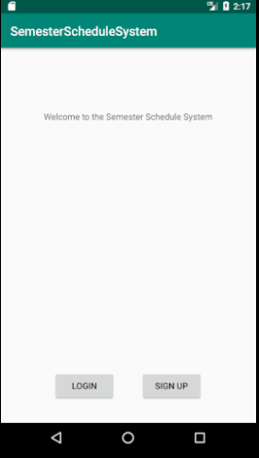
Welcome Screen:

Slide 13
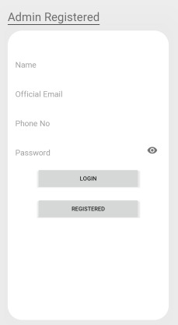
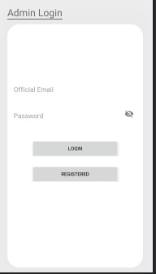
Admin Registration And Login:

Slide 14
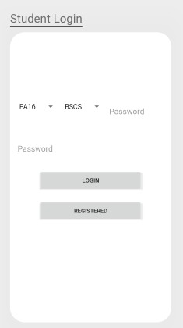
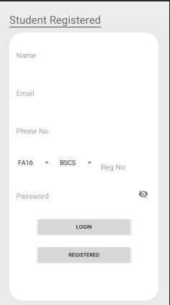
Student Registration And Login:

Slide 15
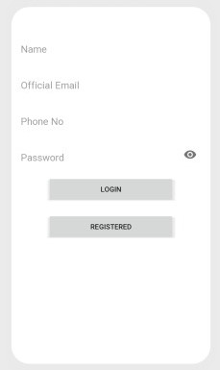
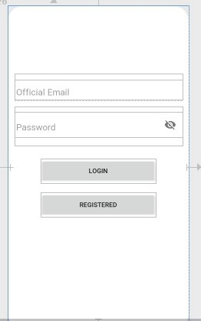
Faculty Registration And Login:

Slide 16
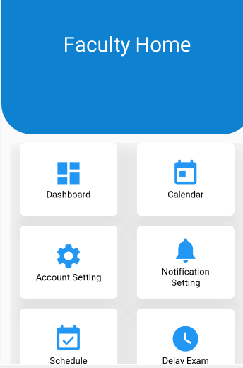
Faculty Panel:

Slide 17
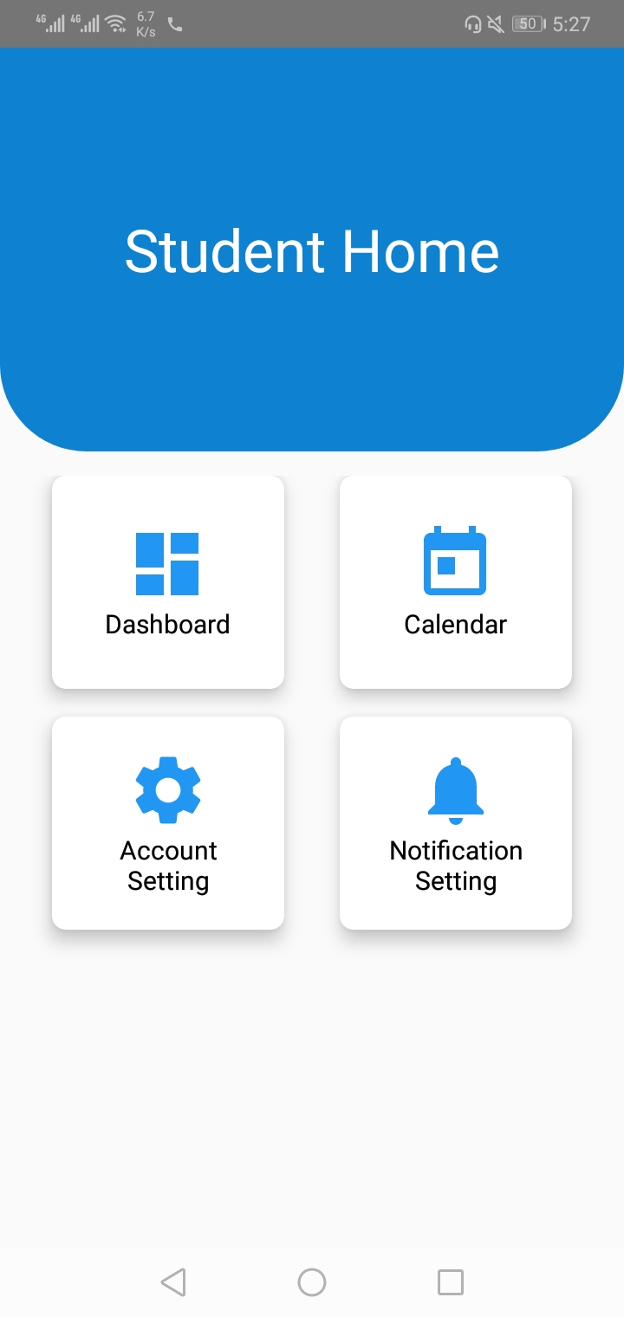
Student Panel:

Slide 18
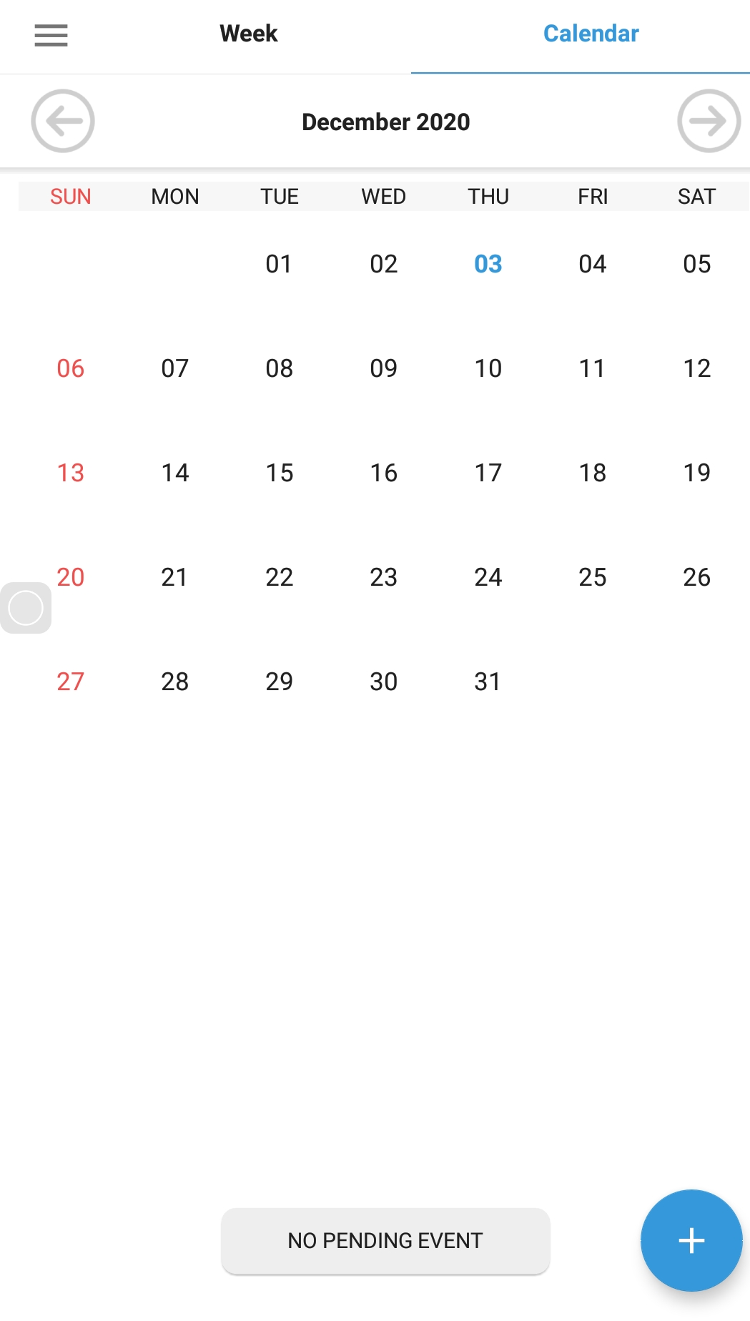
Calendar:

Slide 19
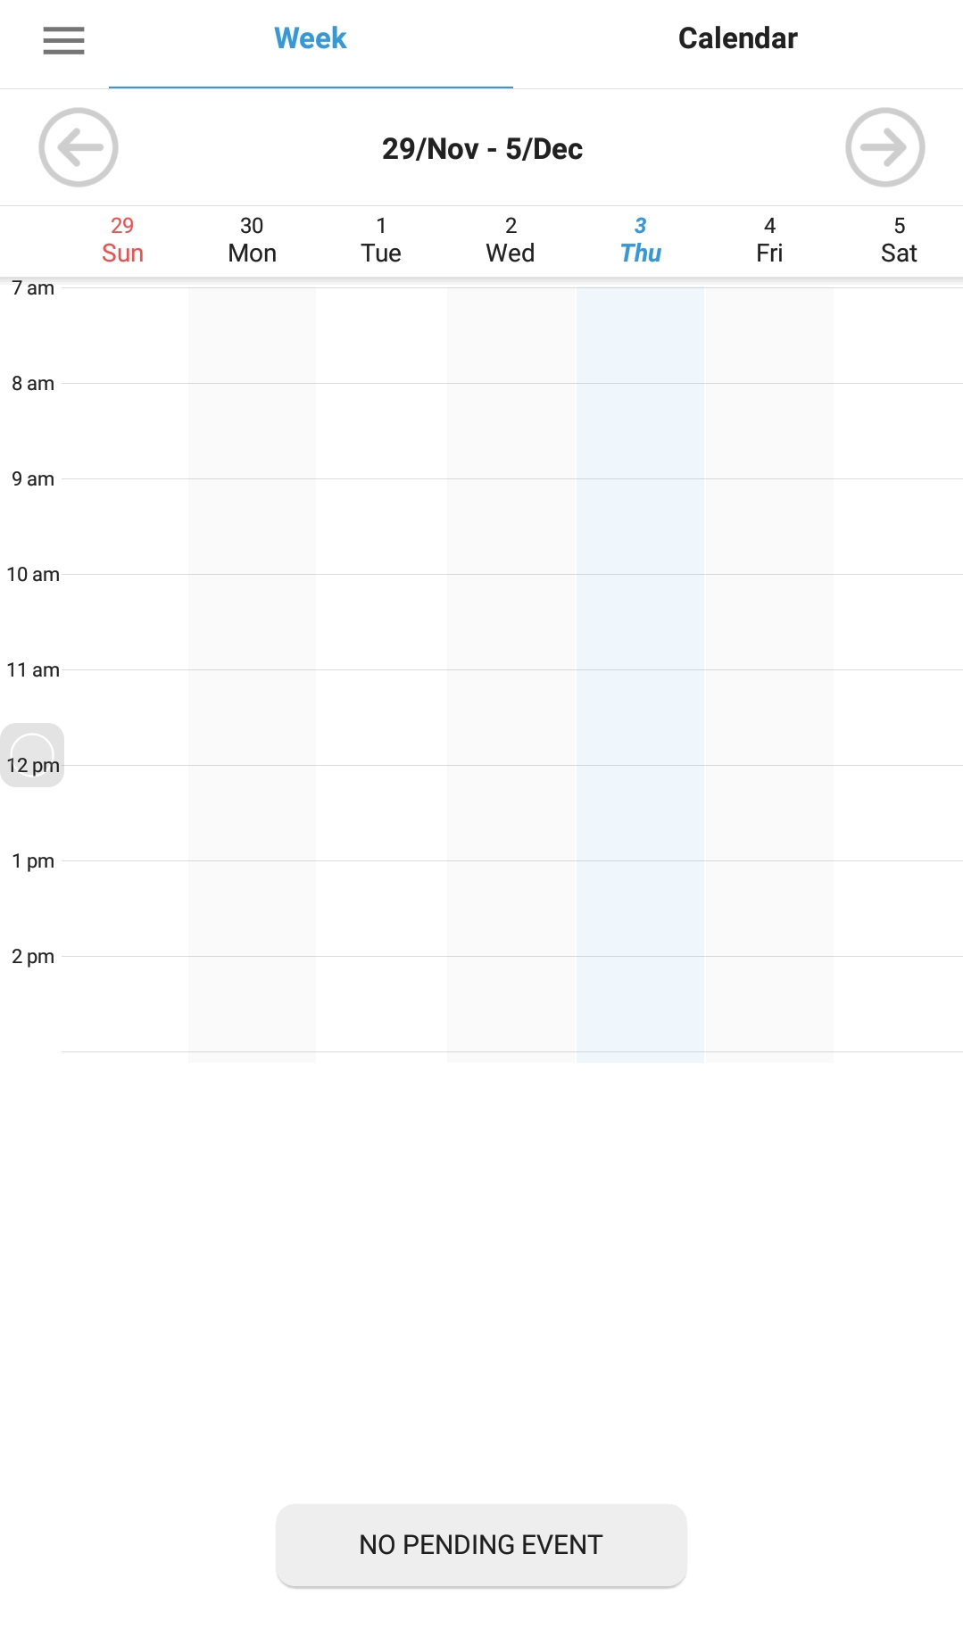
Weekly Schedule:

Slide 20
Conclusion
We developed an android based application whose name is Semester Schedule System There are three panels of this application. One is Admin panel Second is faculty panel and third is Student Panel.
By using student panel the students can see one-day early notification related university task and give feedback for any query. Faculty members also use this application for change the quiz and assignment dates and time and see other university activities such as meeting seminar etc. Admin has rights to Add details for the whole semester for starting date to ending. In this, he will define the whole schedule of the semester such as course registration, fee 1st instalment, quiz, assignment. Course drop, sessional 1 sports week, course withdraw, sessional 2, seminar terminal and final result display

Slide 21
Future work
This application is developed only for university students but in future, this app will be changed to college and school level. More future will be added in this app like class timing,
Fee information section and student marks portal. In further student-teacher panel give access to displayed student quiz assignment marks in students marks panel and.

